Slide 1


IoT Threat Twin for Smart-City Defense:
Multi-Agent Correlation, Drift-Aware Behavior, and Autonomous Response
1

Slide 2


Team members:
Lokpradeep B - AM.SC.U4CYS23018
Uday Ganesh B - AM.SC.U4CYS23019
Sri Charan N - AM.SC.U4CYS23029
Akshara kruti P - AM.SC.U4CYS23035
2
1

Slide 3
ABSTRACT
Modern smart-city infrastructures rely on large-scale Internet of Things (IoT) ecosystems consisting of sensors, cameras, gateways, controllers, and critical monitoring devices. These environments continuously generate massive volumes of heterogeneous security telemetry, making it difficult for traditional security monitoring systems to identify coordinated and evolving cyber threats.
The proposed project, "IoT Threat Twin for Smart-City Defense: Multi-Agent Correlation, Drift-Aware Behavior, and Autonomous Response", introduces a next-generation intelligent security framework that transforms raw IoT telemetry into contextual attack narratives and actionable defense intelligence.
IoT Threat Twin creates a living security representation of the environment capable of understanding what happened, explaining why it happened, predicting what may happen next, and recommending optimal response actions.
3
Notes:
2

Slide 4
ABSTRACT
The framework integrates six major intelligence layers:
IoT Telemetry & Adaptive Deception Layer Captures real-world attacker behavior using IoT devices, smart-city infrastructure logs, and adaptive IoT deception mechanisms.
Drift-Aware Behavioral Analytics Layer Continuously learns device, user, and service behavior while distinguishing legitimate operational changes from malicious deviations.
Temporal Knowledge Graph Engine Correlates security events across time to reconstruct multi-stage attack chains and infer hidden attack relationships.
Network Provenance Graph Engine Models device-to-device interactions and attack propagation paths to detect lateral movement across smart-city infrastructure.
Multi-Agent Threat Intelligence Layer Employs collaborative AI agents including Log Analysis Agents, Threat Intelligence Agents, Correlation Agents, Response Agents, and Report Generation Agents for autonomous investigation and decision support.
Autonomous Response & Threat Narrative Layer Generates explainable attack narratives, predicts potential attack progression, recommends mitigation strategies, and assists security analysts in rapid incident response.
4
Notes:
2

Slide 5
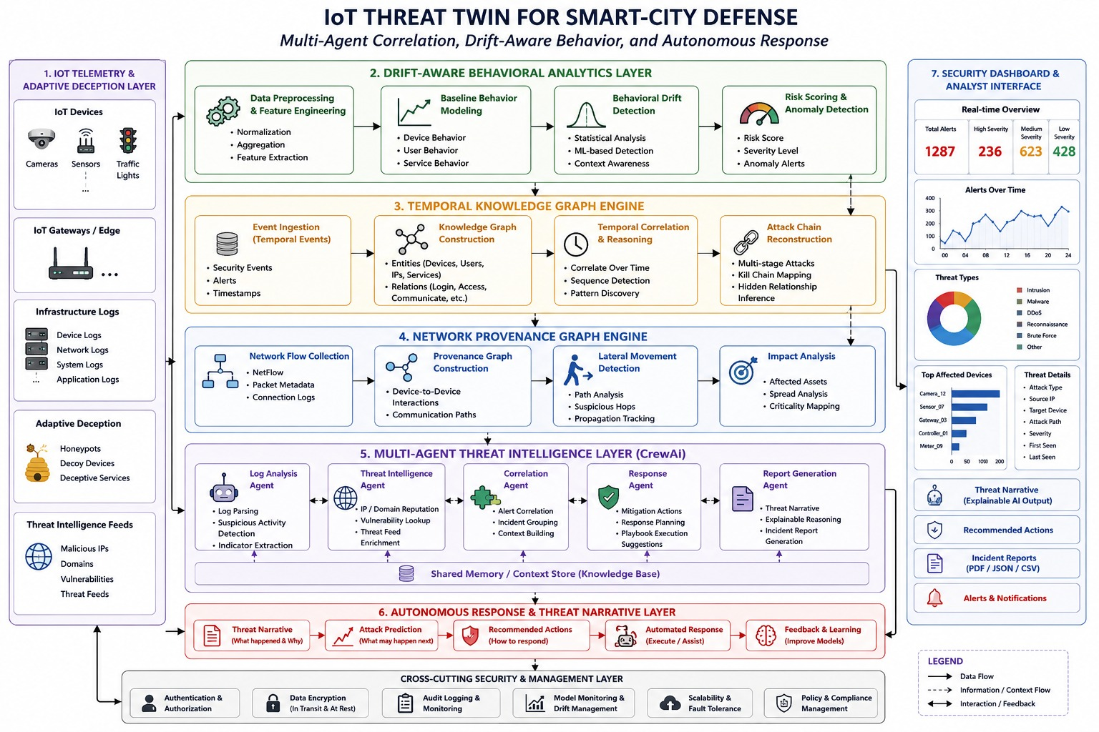
Block Diagram
4
Notes:
2

Slide 6
Work Distribution & Responsibilities
Uday
IoT Infrastructure & Threat Intelligence Lead
Smart-city IoT testbed setup
IoT telemetry collection
IoT honeypot deployment
Device log acquisition
Threat intelligence feed integration
Attack dataset preparation
IoT protocol monitoring
Lokpradeep
Graph Analytics & Attack Reconstruction Lead
Temporal Knowledge Graph design
Network Provenance Graph construction
Graph database development
Attack path reconstruction
Lateral movement detection
Graph visualization
Graph anomaly detection
5
Notes:
2

Slide 7
Work Distribution & Responsibilities
Akshara
Behavioral Analytics & UEBA Lead
Context-aware UEBA framework
Behavioral feature engineering
Device baseline modeling
User/entity profiling
Behavioral drift detection
Risk scoring engine
False positive reduction
Charan
Multi-Agent AI & Autonomous Response Lead
Multi-Agent AI architecture
CrewAI agent orchestration
LLM integration (Llama 3/Ollama)
Alert correlation engine
Threat narrative generation
Autonomous response planning
Explainable AI reasoning
Security dashboard integration
6
Notes:
2

Slide 8
THANK YOU
Notes:
8

